Slide 1
Kinematics
Free Fall
Up &
Down
Newton’s
1st Law
Newton’s
2nd Law
100
100
100
100
100
200
200
200
200
200
300
300
300
300
300
400
400
400
400
400
500
500
500
500
500

Slide 2
If a car accelerates uniformly from rest to 15 m/s over a distance of 100 meters, what is the magnitude of the car’s acceleration?
What is 1.1 m/s² table?

Slide 4
In a race, a runner traveled 12 meters in 4 seconds as she accelerated uniformly from rest. What is the magnitude of the acceleration of the runner?
What is 1.5 m/s²?

Slide 6
A boat initially traveling at 10 m/s accelerates uniformly at the rate of 5.0 m/s² for 10 seconds. How far does the boat travel during this time?
What is 350 m?

Slide 8
A car starting from rest accelerates to a speed of 20 m/s, in a distance of 60 m. What is the acceleration of the car?
What is 3.33 m/s²?

Slide 10
A car traveling on a straight road at 15 m/s accelerates uniformly to a speed of 21 m/s in 12 seconds. What is the total distance traveled by the car in this 12 second time interval?
What is 216 m?

Slide 12
A rock falls from rest off a high cliff. How far has the rock fallen when its speed is 39.2 m/s?
What is 78.0 m?

Slide 14
An object falls freely from rest near the surface of Earth. What is the speed of the object after having fallen a distance at 4.90 meters?
What is 9.80 m/s?

Slide 16
A rock falls freely from rest near the surface of a planet where the acceleration due to gravity is 4.0 m/s². What is the speed of this rock after it falls 32 m?
What is 16 m/s?

Slide 18
A 25 N weight falls freely from rest from the roof of a building. What is the total distance the weight falls in the first 1.0 second?
What is 4.9 m?

Slide 20
An object is allowed to fall freely near the surface of a planet. The object falls 54 meters in the first 3.0 seconds after it is released. The acceleration due to gravity on that planet is:
What is 12 m/s²?

Slide 22
A 3 kg mass is thrown vertically upward with an initial speed of 9.80 m/s. What is the maximum height this object will reach? (Neglect friction)
What is 4.90 m ?

Slide 24
After a model rocket reached its maximum height, it then took 5.0 seconds to return to the launch site. What is the approximate maximum height reached by the rocket? (Neglect friction)
What is 122 m?

Slide 26
A rocket initially at rest on the ground lifts off vertically with a constant acceleration of 2.0x10¹ m/s². How long will it take the rocket to reach an altitude of 9.0x10³ meters?
What is 3.0x10¹ s?

Slide 28
A softball is thrown straight up, reaching a maximum height of 20 meters. Neglecting air resistance, what is the ball’s approximate vertical speed when it hits the ground?
What is 19.8 m/s?

Slide 30
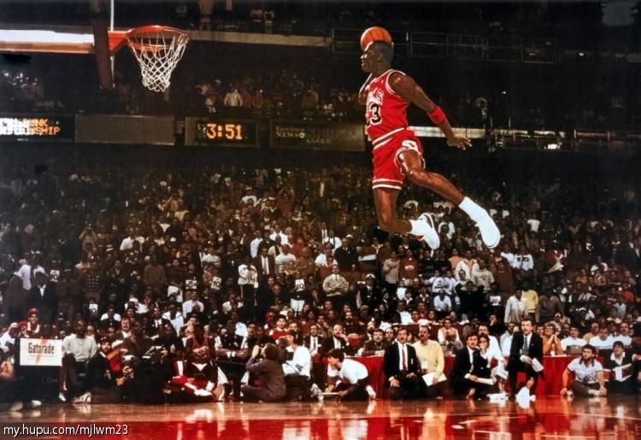
Michael Jordan was said to have a hang-time of 3.0 seconds (at least according to a popular NIKE commercial). What is the height to which MJ could leap if he was wearing NIKE shoes and had a hang-time of 3.0 seconds?
What is 11.04 m?

Slide 32
Fred spends most Sunday afternoons at rest on the sofa, watching pro football games and consuming large quantities of food. What affect (if any) does this practice have upon his inertia?
What is Fred’s inertia will increase?
Notes:
Fred will increase his mass if he makes a habit of this. And if his mass increases, then his inertia increases.

Slide 34
If the forces acting upon an object are balanced, then the object: a) must not be moving b) must be moving with a constant velocity c) must not be accelerating d) none of these
What is c) must not be accelearting?

Slide 36
A 15-kg cart is at rest on a horizontal surface. A 5-kg box is placed in the cart. Compare the mass and inertia of the cart-box system with the mass and the inertia of the cart.
What is more mass and more inertia for the cart-box system?

Slide 38
Which situation describes an object that has no unbalanced force acting on it?
A) an apple in free fall
B) A satellite orbiting Earth
C) A hockey puck moving at constant velocity across ice
D) A laboratory cart moving down a frictionless 30° incline
What is C?
Notes:
C) A hockey puck moving at constant velocity across ice

Slide 40
A 4.0-kg object is moving across a friction-free surface with a constant velocity of 2 m/s. What horizontal forces is necessary to maintain this state of motion?
What is 0 N?
Notes:
None! It doesn’t take any force to maintain a state of motion. An object in motion, stays in motion and an object at rest, stays at rest. In fact, a presence of any force would “ruin” such a state of motion and cause an acceleration.

Slide 42
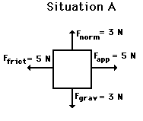
What is the net force acting on the object in the diagram below?
What is 0 N?

Slide 44
An 80-kg box is pushed along the surface of the floor with an acceleration of 2 m/s². What is the net force acting on the box?
What is 160 N?

Slide 46
A 4.0 kg object is accelerated at 3.0 m/s² North by an unbalanced force. If the same unbalanced force is acting on a 2.0 kg object, what would the magnitude of acceleration for this object be?
What is 6.0 m/s²?

Slide 48
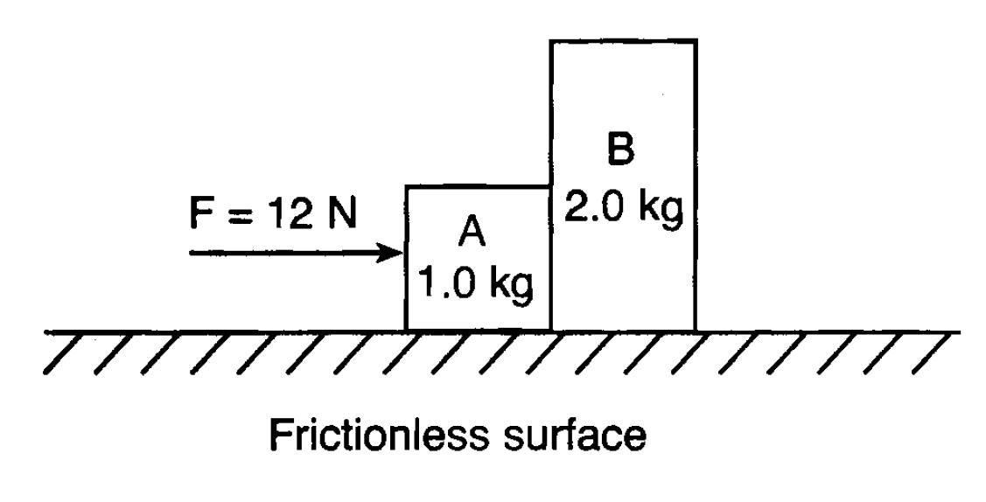
According to the diagram below, what is the magnitude of the acceleration of block B?
What is 4.0 m/s²?

Slide 50
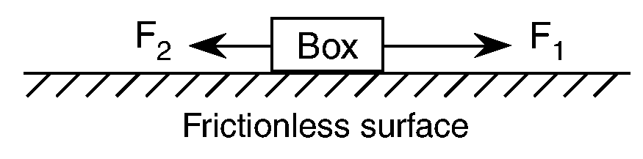
The diagram below shows a box on a frictionless horizontal surface, with forces F₁ and F₂ acting on it. If the magnitude of F₁ is greater than the magnitude of F₂, then the box is:
A) moving at constant speed in the direction of F₁
B) Moving at constant speed in the direction of F₂
C) Accelerating in the direction of F₁
D) Accelerating in the direction of F₂
What is choice C?

